Slide 1
Blair Road / Cedar Street / 4th Street
Intersection Improvements
August 1, 2019

Slide 2
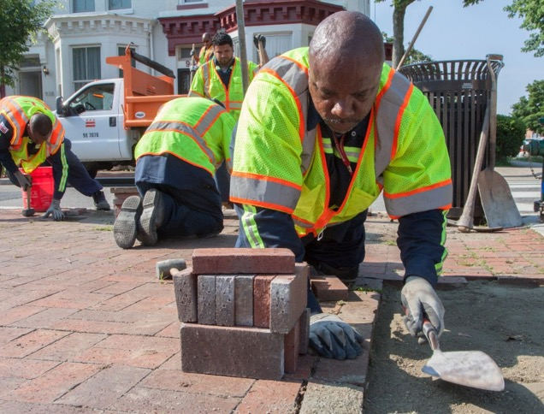
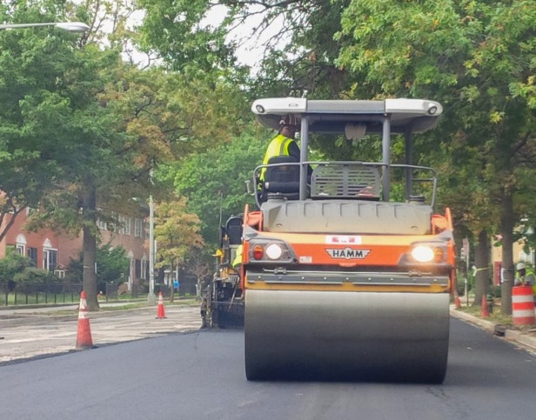
PROJECT TEAM
DDOT – Sponsor
Volkert – Engineer of Record
Parsons – Construction Manager
Capital Paving – Contractor

Slide 3
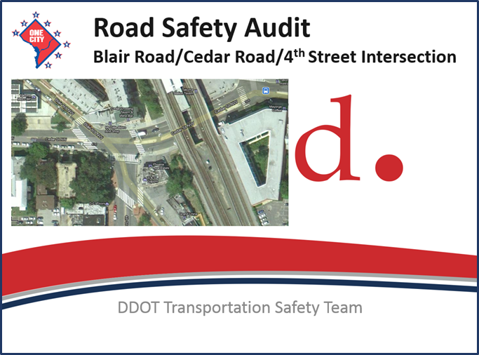
2014 ROAD SAFETY AUDIT RECOMMENDATIONS REPORT

Slide 4
ACCIDENT ANALYSIS
3-year accident analysis
Total 24 accidents from 2008-2010
  Blair/Cedar – 15 accidents (60%)
  4th/Cedar – 7 accidents (30%)
  Blair/4th – 2 accidents (10%)
11 out of 24 accidents (50%) resulted in injuries
4 out of 24 accidents (20%) resulted in disabling injuries

Slide 5
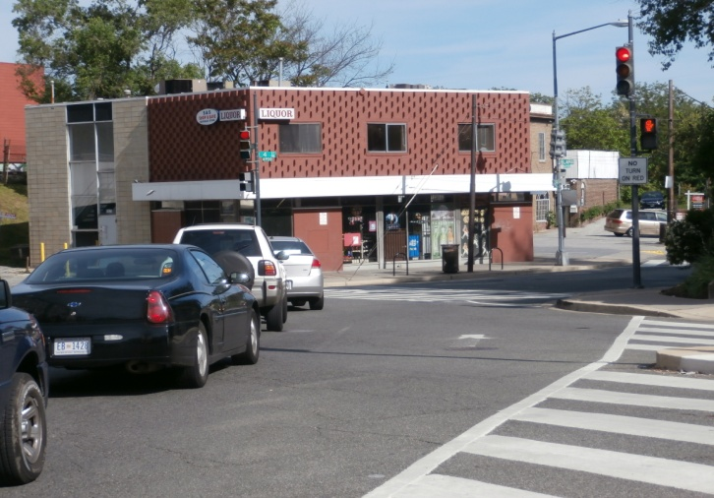
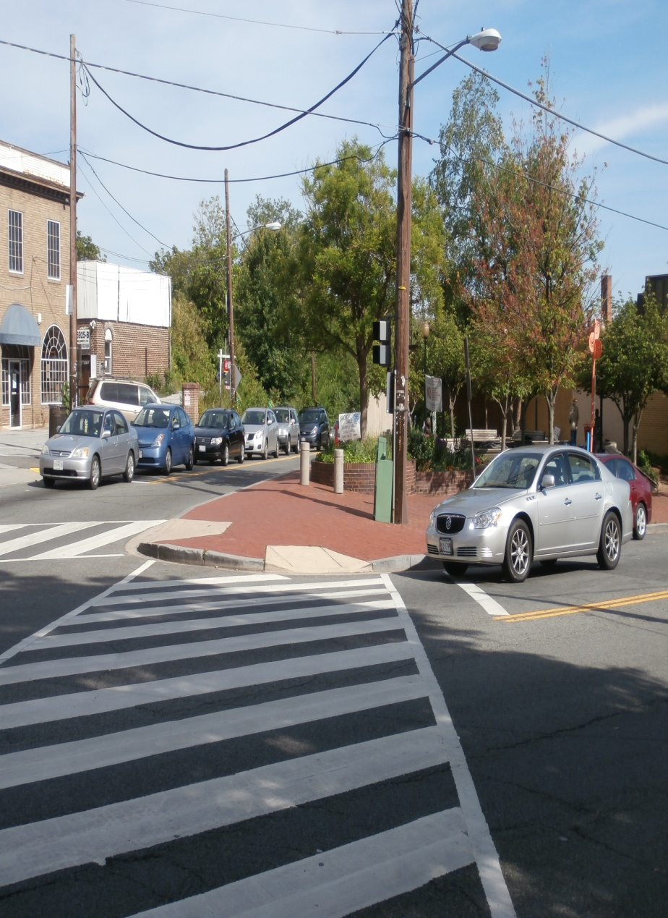
TRAFFIC ANALYSIS
Estimated 2010 Average Daily Traffic Volumes
    Blair Road – 15,000 vehicles
    Cedar Street – 5,300 vehicles
    4th Street – 1,600 vehicles
Speed study shows 32 mph speed on Blair Road which is significantly higher than posted 25 mph speed limit

Slide 6
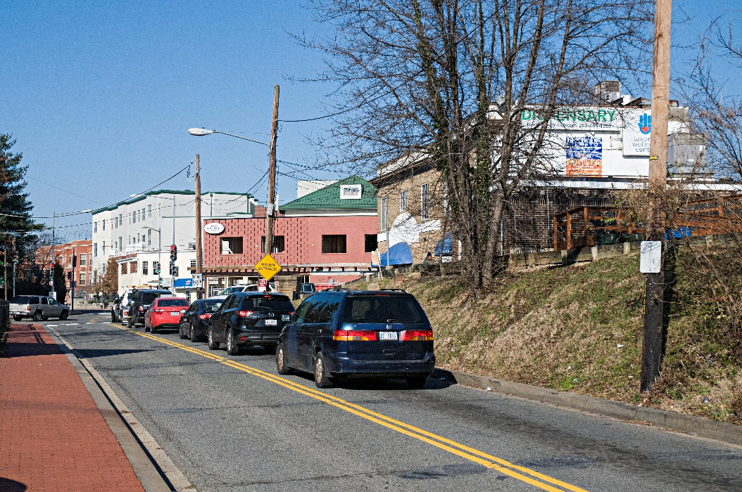
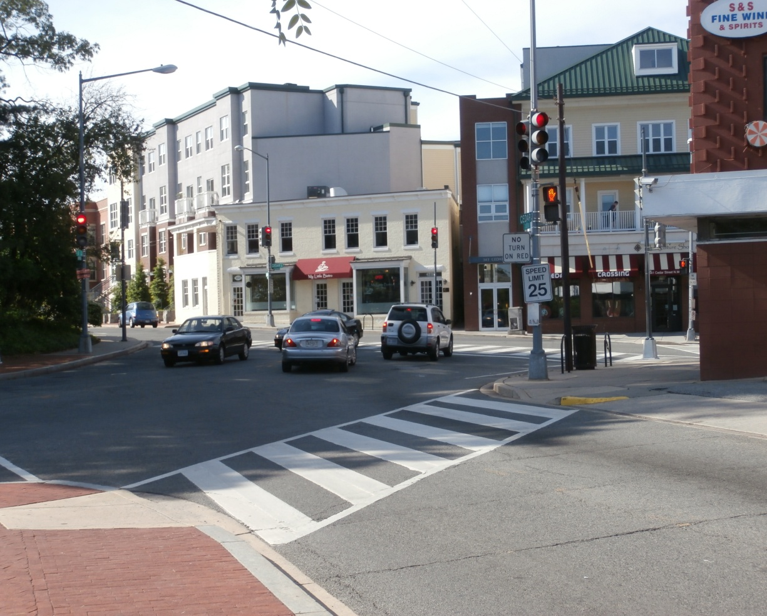
TRAFFIC ANALYSIS
Existing level of service (LOS) analysis at 21 intersections along Blair Road, Piney Branch Road, Aspen Street, Butternut Street, and Cedar Street
Blair Road/Cedar Street/4th Street intersection:
  LOS E during AM peak-hour
  LOS F during PM peak-hour
Blair Road intersection at Piney Branch Road:
  LOS E during AM peak-hour
Remaining study intersections:
  LOS D or better during both AM and PM peak-hour

Slide 7
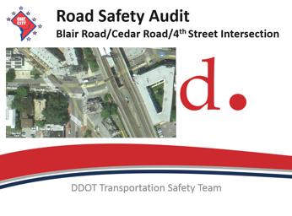
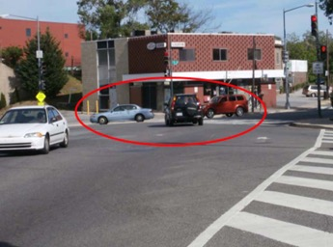
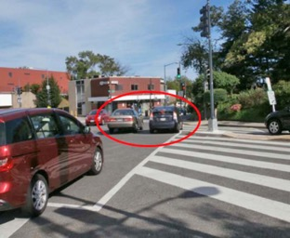
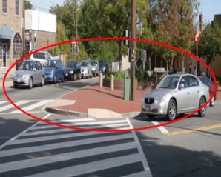
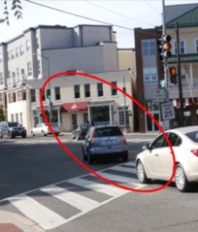
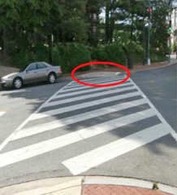
2014 ROAD SAFETY AUDIT RECOMMENDATIONS REPORT
Safety issues identified are
as follows:
  Inadequate sight distance
  Pedestrian/vehicle conflicts
  High accident frequency
  Insufficient traffic signs
  Potholes, cracks and faded pavement markings
  Pedestrian facilities not compliant with ADA requirements

Slide 8
PROPOSED IMPROVEMENTS
Re-configuring the Blair Road / Cedar Street intersection
Convert 4th Street to one-way southbound and add bicycle lane
Re-constructing pavement, median, and sidewalk sections including new accessible curb ramps and a new ornamental median safety fence at Cedar Street
Roadway widening to provide adequate turning movements for WMATA buses
Upgrading traffic signals, parking meters and other traffic control devices
Installation of new street lights (poles, arms, and luminaires)
Adjusting and upgrading water and sewer lines, as well as new fire hydrants
Installing low impact stormwater management facilities and green planting areas
END PROJECT
BLAIR RD., N.W.
STA. 56+50.00
BEGIN PROJECT
CEDAR ST., N.W.
STA. 27+50.00
END PROJECT
CEDAR ST., N.W.
STA. 31+00.00
BLAIR RD., N.W.
CEDAR ST., N.W.
WMATA
5TH ST., N.W.
4TH ST., N.W.
BLAIR RD., N.W.
VINE ST., N.W.
BUTTERNUT ST., N.W.
BEGIN PROJECT
4TH ST., N.W.
STA. 10+24.00
BEGIN PROJECT
BLAIR RD., N.W.
STA. 49+50.00

Slide 9
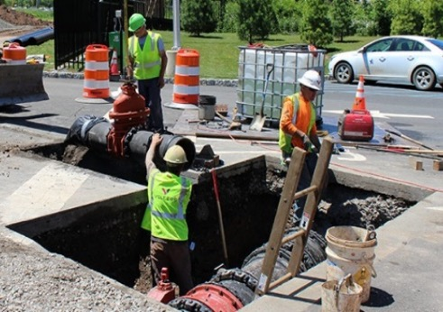
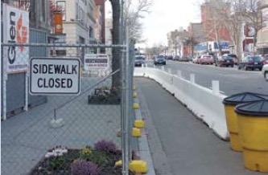
MAINTENANCE OF TRAFFIC (MOT) CONSIDERATIONS
Design incorporates MOT considerations as HIGH PRIORITY to protect public
During construction, Contractor shall open all lanes to traffic during peak hours – Monday thru Friday (6:30 – 9:30 a.m. and 3:30 – 6:30 p.m.)
  One lane in each direction maintained at all other times
  Construction related disruptions shall be minimized
  Maintain ADA compliant safe flow of pedestrian traffic within and adjacent to project area
  Maintain pedestrian access to abutting properties
  Provide notification to affected parties for temporary curtailment of access
  Contractor shall install appropriate signage

Slide 10
CONSTRUCTION PHASES 1 – 4
Phase 1. Removal and pavement restoration of median along Cedar Street west of Blair Road.
Phase 2. Removal and replacement of median along Cedar Street east of Blair Road.
Phase 3. Reconstruction of northern sidewalk and ramps along Cedar Street east of Blair Road.
Phase 4. Reconstruction of northern sidewalk, ramps, and LID facility along Cedar Street west of Blair Road, and construction of bus bay along Blair Road.
BLAIR RD., N.W.
4
3
CEDAR ST., N.W.
2
1
WMATA
5TH ST., N.W.
4TH ST., N.W.
BLAIR RD., N.W.
VINE ST., N.W.
4
BUTTERNUT ST., N.W.
Extent of Project/
Pavement Reconstruction

Slide 11
CONSTRUCTION PHASES 5 – 8
Phase 5. Reconstruction of ramps, sidewalk and LID facility along southside of Cedar Street and extension of curb along 4th Street west of Blair Road.
Phase 6. Reconstruction of sidewalk and ramps in the southeast corner of Cedar Street and Blair Road.
Phase 7. Construction of bulb out along 4th Street at the intersection with Blair Road.
Phase 8. Construction of sidewalk, ramps and curb extension along 4th Street at Butternut Street.
BLAIR RD., N.W.
CEDAR ST., N.W.
6
5
WMATA
7
5TH ST., N.W.
4TH ST., N.W.
BLAIR RD., N.W.
VINE ST., N.W.
8
BUTTERNUT ST., N.W.
Extent of Project/
Pavement Reconstruction

Slide 12
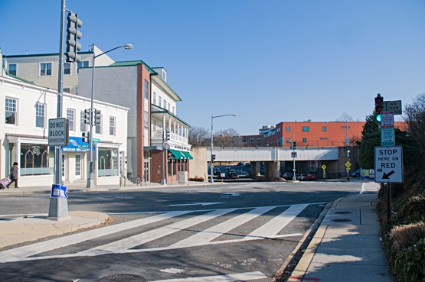
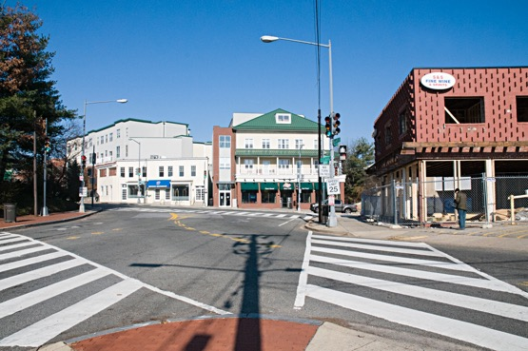
KEEP UP-TO-DATE
Project Website
  https://ddot.dc.gov/page/4thblaircedar-nw-intersection-improvements
Project Mailing List
DDOT Traffic Advisories
Project Contacts
  Stephen Walter – Parsons
  stephen.c.walter@parsons.com
  571-842-6357 (o)
  703-517-4184 (m)
  Alberta Paul – DDOT Communications
  alberta.paul@dc.gov
  202-671-4667 (o)
  202-437-3807 (m)

